Slide 1
Graham Price PhD Dissertation Defense
Dynamic Trace Analysis with ZDDs
Advised by Dr. Manish Vachharajani
Department of Electrical, Computer, and Energy Engineering
University of Colorado at Boulder
04/08/2011
Notes:
Intro..

Slide 2

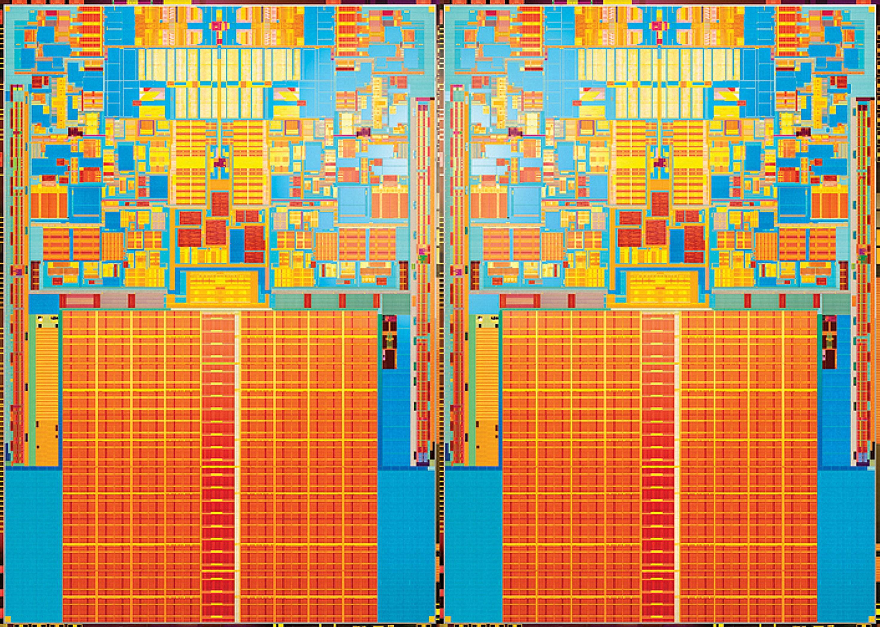
Solving Puzzles with Dynamic Analysis
(Intel Single Core)
(Intel Quad Core)
Hot Code Detection
Instruction Level Parallelism
Loop Level Dependencies
Thread Level Speculation
Code
Analysis
Test
Notes:
----- Meeting Notes (4/7/11 21:10) -----
Traditional dynamic analysis works well when you know exactly what you are looking, but makes exploration of opportunities difficult.

Slide 3
Hypothesis
ZDD-based dynamic trace analysis can identify hot-code paths, irrelevant instructions, and potential coarse-grained thread level parallelism in sequential codes, and thus find opportunities for program optimization.
Notes:
----- Meeting Notes (4/7/11 21:10) -----
This work focuses on a ZDD-based dynamic trace analysis framework that permits exploration.

Slide 4




Dynamic Analysis Puzzle Solving
Find Opportunities
Scalable Framework
Multi Core Analysis
Single Core Analysis
Notes:
----- Meeting Notes (4/7/11 21:10) -----
The are four main components to building this framework - techniques to find opportunities, techniques for multicore analysis, techniques for single core analysis, and finally data structures and algorithms to make all of these scalable.

Slide 5
Dynamic Analysis Puzzle Solving
Find Opportunities
Scalable Framework
Multi Core Analysis
Single Core Analysis

Slide 6
DIN vs. Ready Time
DIN
Instruction
Mem Addr
DIN
Ready Time
…
13
13
mov r3,r4
13
12
12
st 0(r1),r5
0xbee4
12
11
11
add r5,r3,r4
11
10
10
bnz r2, loop
10
9
9
addi r1,r1,4
9
8
8
addi r2,r2,-1
8
7
7
mov r4,r5
7
6
6
mov r3,r4
6
5
5
st 0(r1),r5
0xbee0
5
4
4
add r5,r3,r4
4
3
3
mov r3, 1
3
2
2
mov r4, 1
2
1
1
mov r2, 8
1
0
0
li r1, &fibarr
0
0
1
2
3
4
5
6
7
8
9
10
11
12
13

Slide 7
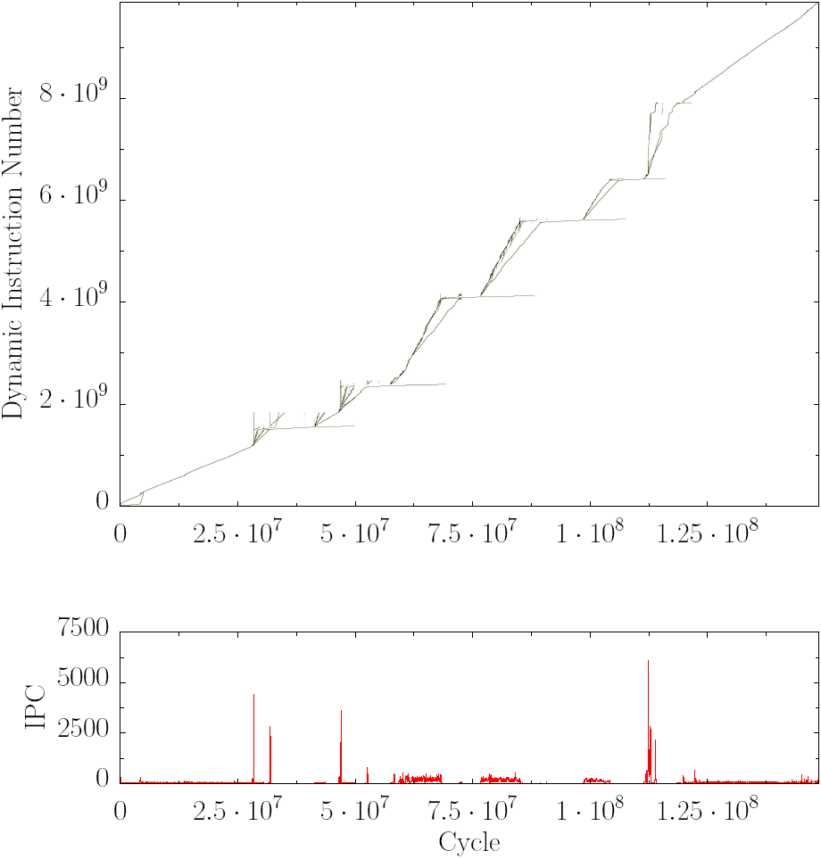
Distant ILP Characteristics
DINxRDY plot for 254.gap
Multiple
Dep. chains
Divergent lines indicate parallel “threads” of execution
Independent chains of dependences (DDCs)
Postiff et al. (JILP 1999)
Iyer et al. (EPIC 2005)
Notes:
The DDCs overlap in time, and can be potential threads

Slide 8
Compression Methods
Run Time Linear Compression
Requires trace compression/decompression
TCGen (Burtscher and Sam, CGO 2005)
Hierarchical Grammars
Requires full grammar traversal for some analysis
SEQUITUR (Nevill-Manning and Witten, DCC 1997)
Stride Compression
Locates dynamic dependence conflicts in loops
SD3 (Kim et. al., Micro 2010)

Slide 9
Binary Decision Diagram (BDD)
False Arc
Inverting
False Arc
True Arc
F(X,Y,Z,W) = X*Y*Z*W
X
X
Y
Y
W
Y
W
Z
W
W
W
Z
Z
Z
Z
Z
Z
Z
Z
0
0
0
0
0
0
1
0
0
0
0
0
0
0
1
0
0

Slide 10
Trace BDD Construction
DIN
Ready Time
13
12
11
10
9
8
7
6
5
(0,2)
4
3
2
(0,1)
1
0
0
1
2
3
4
5
6
7
8
9
10
11
12
13
(0,0)

Slide 11
Trace BDD Construction
Data Tuple
Binary Tuple
Boolean Function
(0,0)
(00,00)
(X’ * Y’ * Z’ * W’)
(0,1)
(00,01)
(X’ * Y’ * Z’ * W)
(0,2)
(00,10)
(X’ * Y’ * Z * W’)
f_{trace} = (X’ * Y’ * Z’ * W’) + (X’ * Y’ * Z’ * W) + (X’ * Y’ * Z * W’)

Slide 12
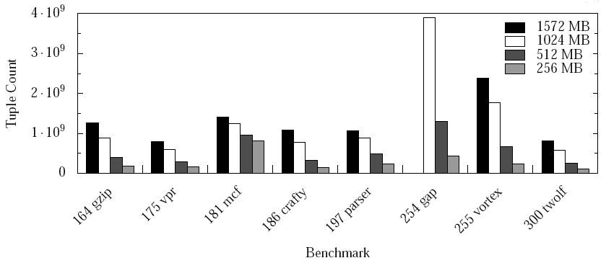
BDD Trace Representation
Compression ranges from 16x to over 60x
BDD Based Analysis
[Whaley and Lam, PLDI 2004]

Slide 13
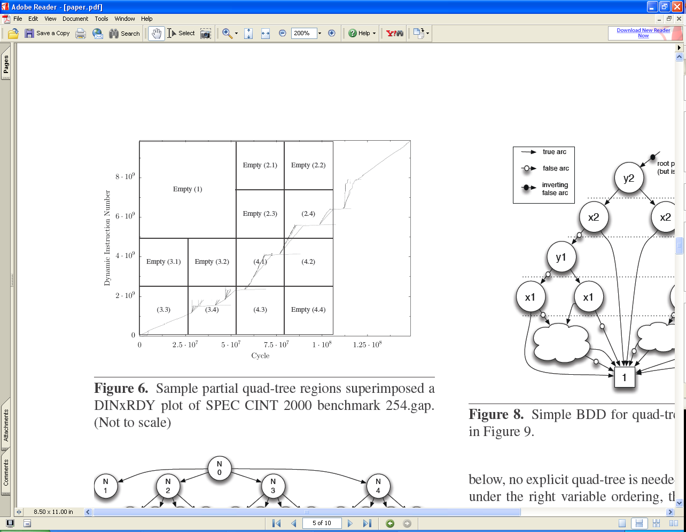
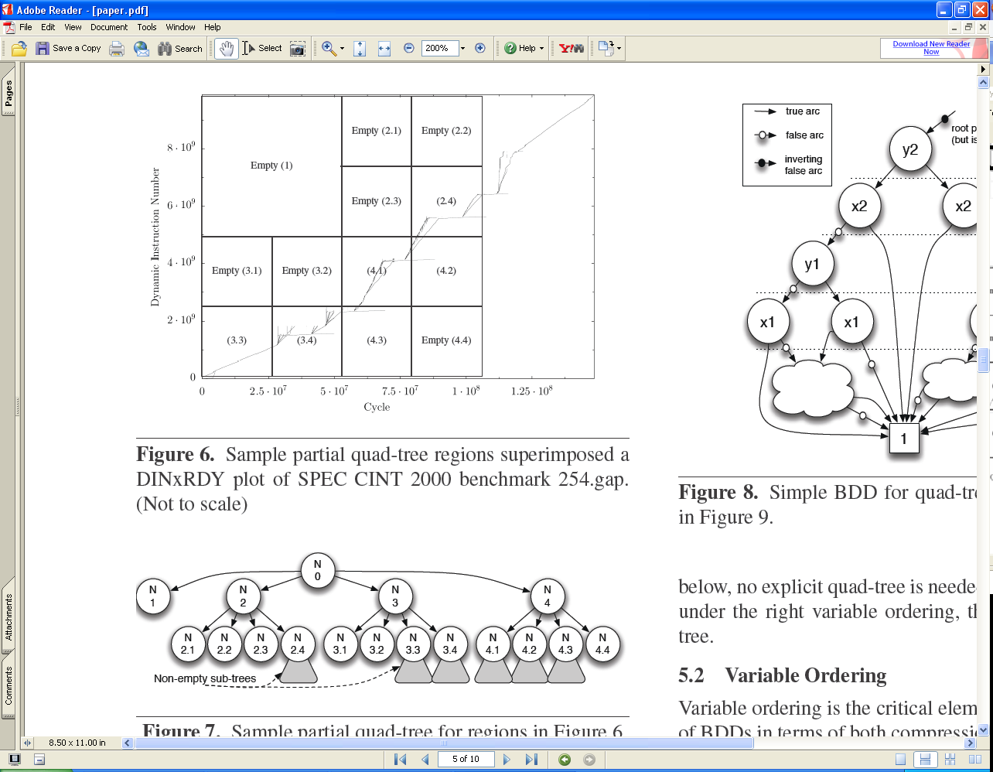
Quad Tree Image Rendering

Slide 14
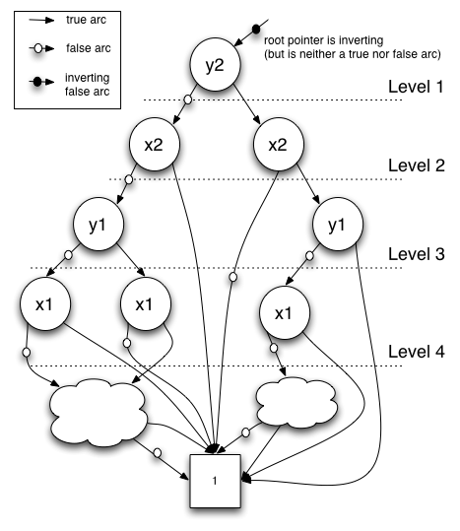
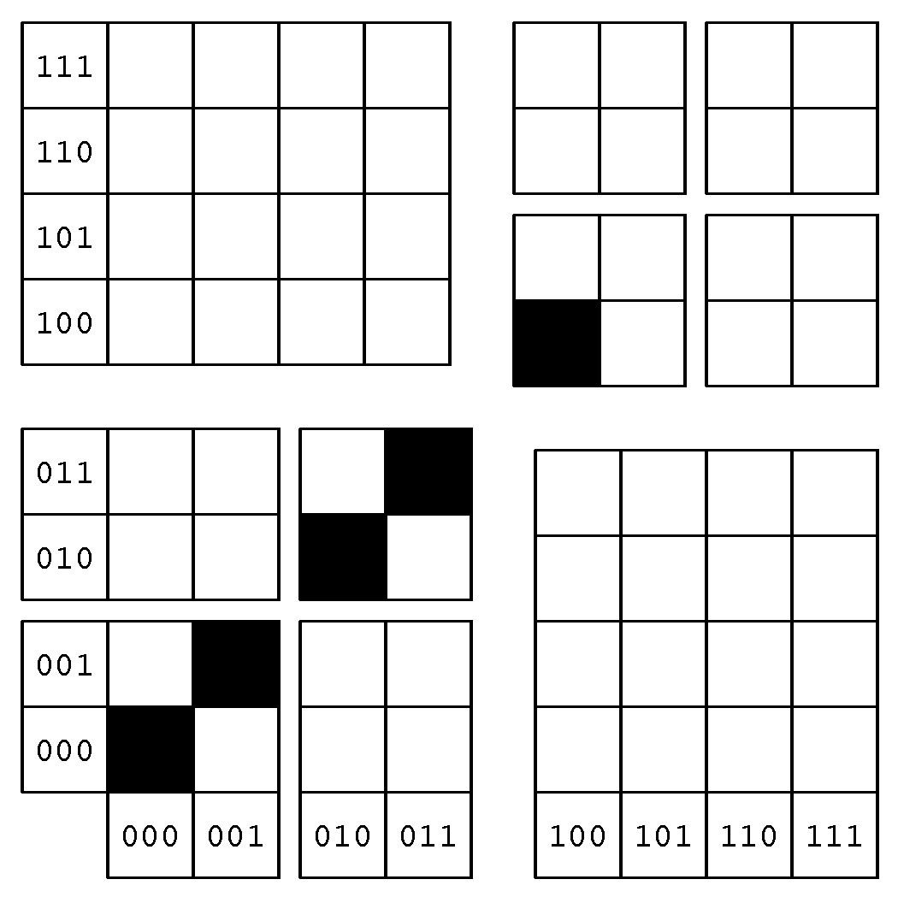
BDDs as Quad-Trees

Slide 15
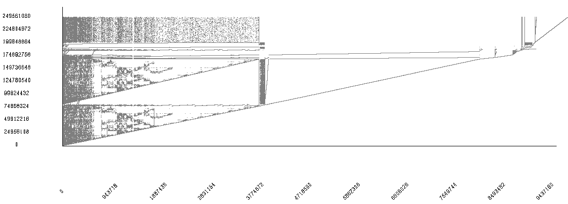
175.vpr Case Study
γ
β
α

Slide 16
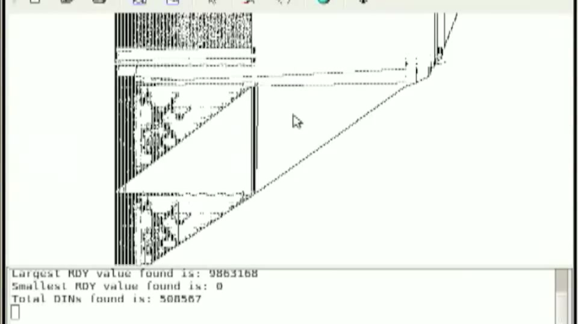
DINxRDY Visualization

Slide 17
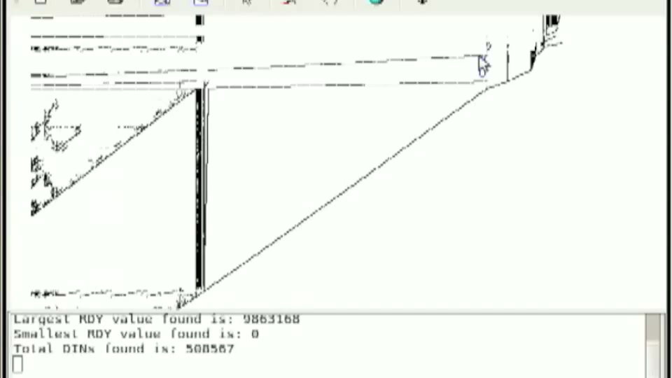
Dynamic Slicing

Slide 18
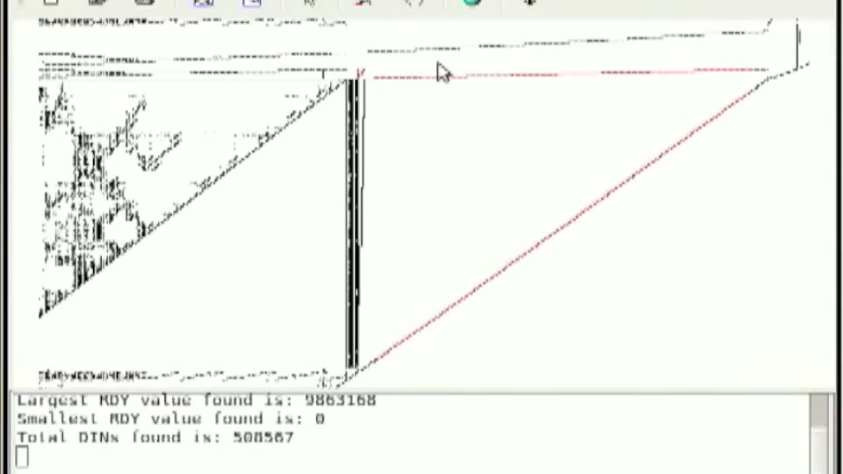
DINxRDY to Source

Slide 19
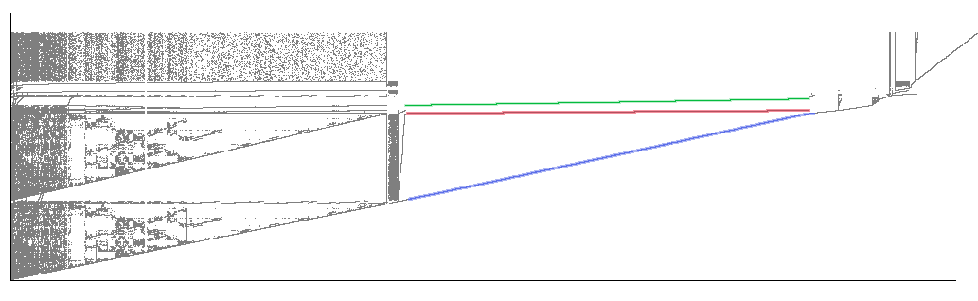
ParaMeter - Extracting TLP
γ
β
α
α
α
α
β
β
β
γ
γ
γ
Time
Time

Slide 20

Dynamic Analysis Puzzle Solving
Find Opportunities
Scalable Framework
Multi Core Analysis
Single Core Analysis

Slide 21
BDD Creation Time
(hrs)
250 million instructions

Slide 22
Trace BDD Construction
X
X
X
Y
Y
Y
=
+
W
W
Z
Z
Z
1
1
1
f_{trace} = (X * Y * Z * W) + (X’ * Y’ * Z’ * W’)
f_{d0} = (X’ * Y’ * Z’ * W’)
f_{d1} = (X’ * Y’ * Z’ * W)

Slide 23
BDD Garbage Collection Time

Slide 24

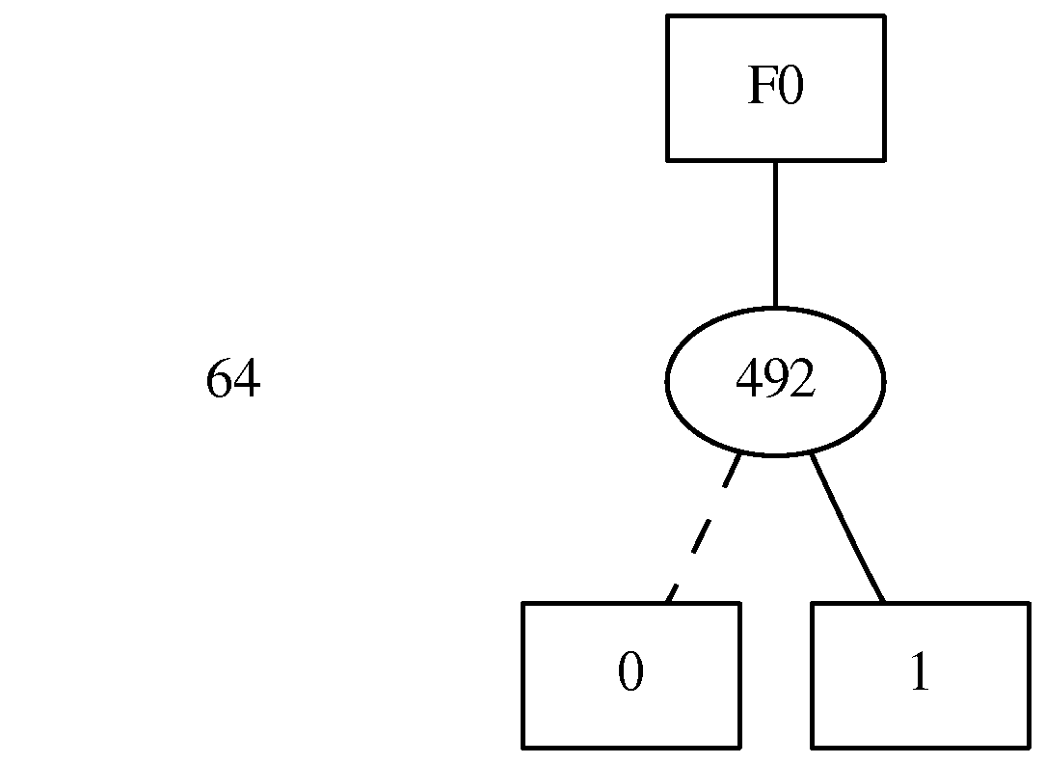
Zero-Suppressed BDD (ZDD)
BDDs
Remove isomorpic graphs
Skip and remove nodes whose pointers point to the same child
ZDDs
Remove isomorpic graphs
Remove nodes whose “then” arc points to the constant 0

Slide 25
Trace ZDD Gains
~ 20% Reduction

Slide 26
Trace ZDD Construction
Over 9x faster than BDD construction!

Slide 27
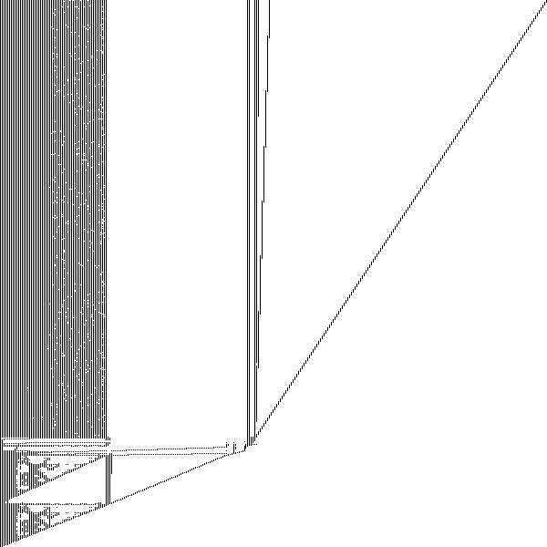
Scalable Framework
γ
β
α
γ
β
α

Slide 28
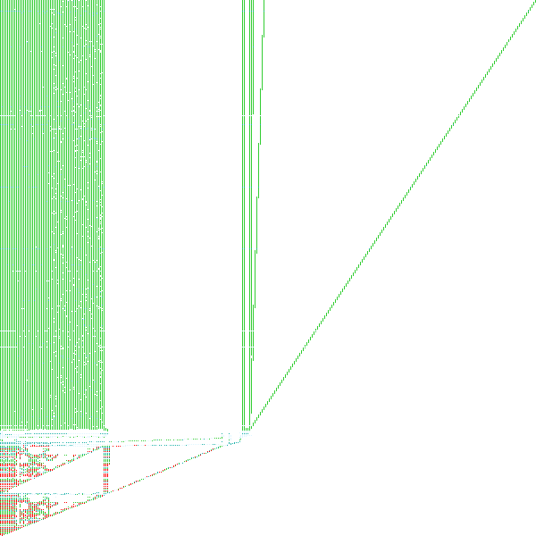
Scalable Framework

Slide 29

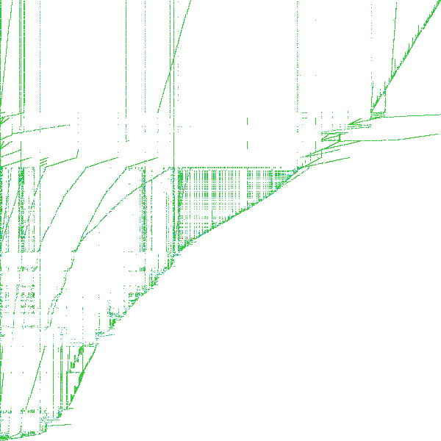


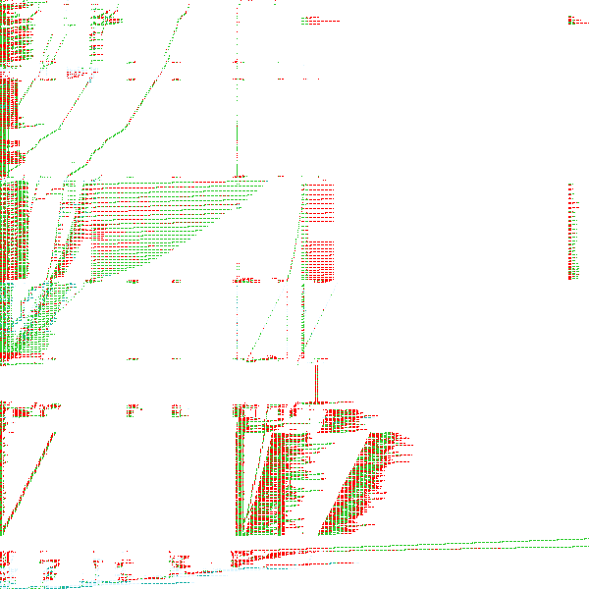
Scalable Framework
164.gzip
176.gcc
252.eon
175.vpr
197.parser
255.vortex

Slide 30
Dynamic Analysis Puzzle Solving
Find Opportunities
Scalable Framework
Multi Core Analysis
Single Core Analysis

Slide 31
Hot Code Analysis
γ
β
α

Slide 32

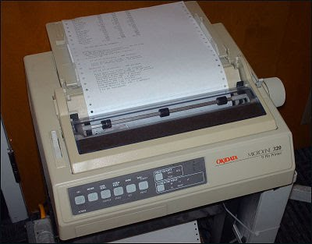
Irrelevant Instruction Detection
Reaches the end
Produces an output

Slide 33
Irrelevant Instruction Detection
SPEC INT 2006
Compare –O0 and –O2

Slide 34
Dynamic Analysis Puzzle Solving
Find Opportunities
Scalable Framework
Multi Core Analysis
Single Core Analysis

Slide 35
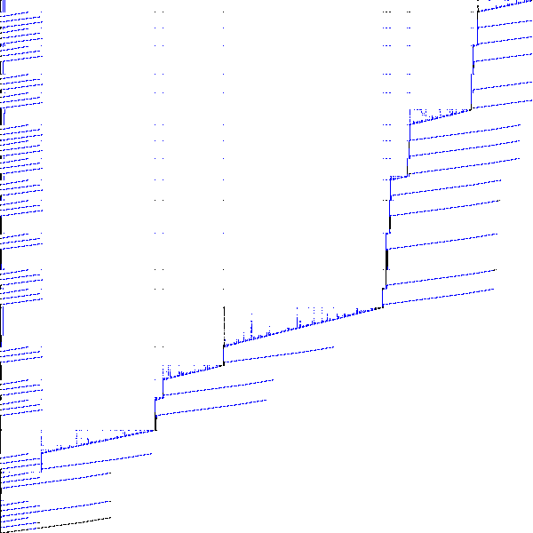
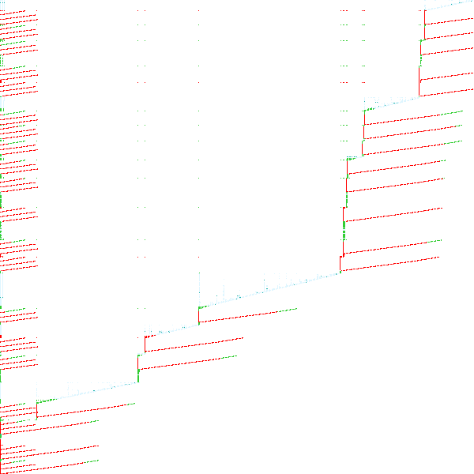
445.gobmk TLP Region Selection

Slide 36
445.gobmk Naïve Parallelism
DINs
Overlap on RDY

Slide 37
445.gobmk Naïve Parallel Count
Nine Threads

Slide 38
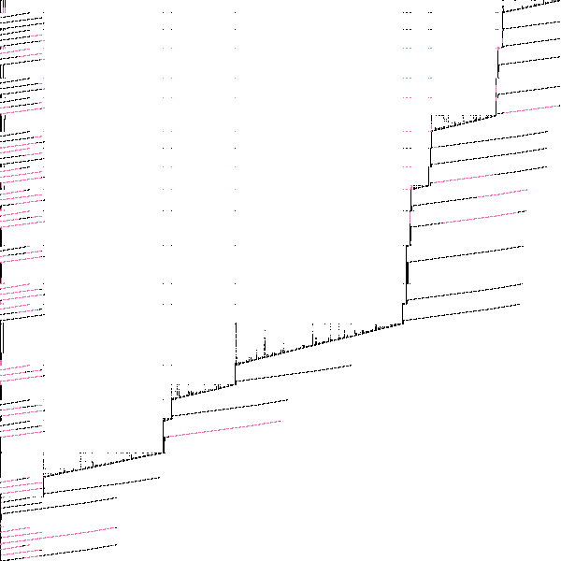
Inter-Region Dependencies
Intersection
Reverse Slice
Forward Slice
Intersection - Days to Weeks

Slide 39
Inter-Region Dependency Chopping
Chop
Reverse Slice
Forward
Edge Slice
Chop – Hours to Days

Slide 40
445.gobmk Inter-Region Dependencies

Slide 41
Coarse-Grained Parallelism
Parallel Instructions
Thread Count

Slide 42
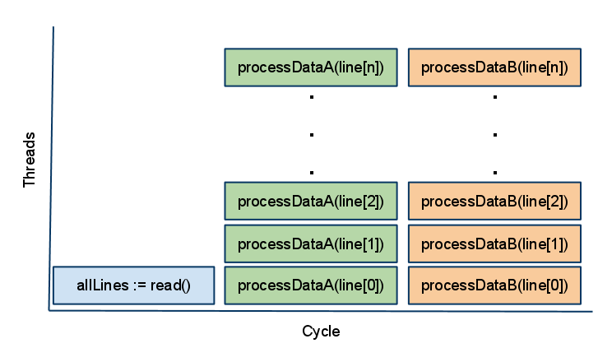
Fine-Grained Thread Level Speculation
allLines := read()
foreach line in allLines
processDataA(line)
foreach line in allLines
processDataB(line)
Max n Cores

Slide 43
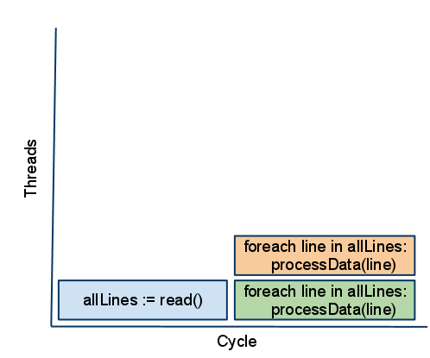
Coarse-Grained Thread Level Parallelism
allLines := read()
foreach line in allLines
processDataA(line)
foreach line in allLines
processDataB(line)
Max 2 Cores

Slide 44
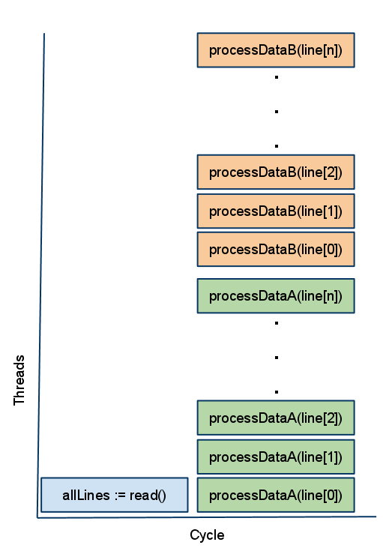
Fine-and-Coarse Grained Harmony
allLines := read()
foreach line in allLines
processDataA(line)
foreach line in allLines
processDataB(line)
Max 2n Cores

Slide 45
Dynamic Analysis Puzzle Solving
Find Opportunities
Scalable Framework
Single Core Analysis
Multi Core Analysis

Slide 46
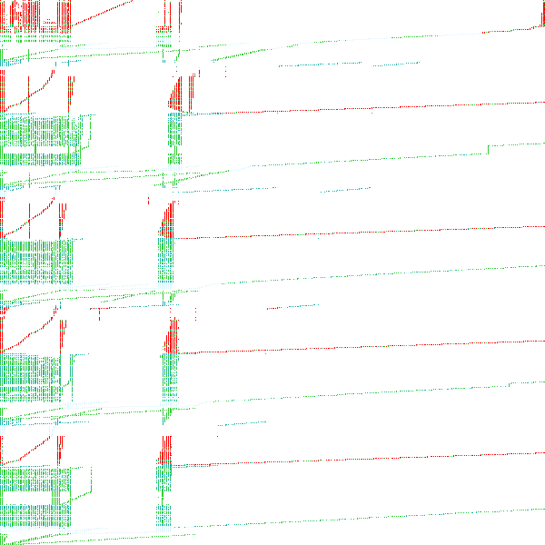
What Just Happened?
Traces to BDDs
Visualized BDDs
Scalability - ZDDs
Hot Code
Irrelevant Code
Coarse-Grained TLP Survey
=
+
164.gzip
176.gcc
252.eon
175.vpr
197.parser
255.vortex

Slide 47
Contributions
A ZDD-based trace compression algorithm with tuning for large traces, resulting in a 25% reduction in BDD size and a 9x reduction in trace compression time.
A ZDD-based iterative analysis for locating irrelevant instruction dependencies
A method to quickly explore coarse-grained parallelism in serial applications.
A ZDD-based dependence graph chopping algorithm need for the aforementioned method.
A survey of coarse-grained thread level parallelism in the SPEC INT 2006 benchmarks that shows up to 44% of instructions may be extractable as coarse grain TLP.

Slide 48
Questions?
Price and Vachhajarani. A Case for Compressing Traces with BDDs. CAL 2006
Price, Giacomoni, Vachharajani. Visualizing Potential Parallelism in Sequential Programs. PACT 2008
Price and Vachharajani. Large Program Trace Analysis and Compression with ZDDs. CGO 2010
Price and Vachharajani. A Survey of Coarse-Grained Thread Level Parallelism in SPEC 2006. PACT 2011 [Submitted]

Slide 49
Bonus Slides

Slide 50
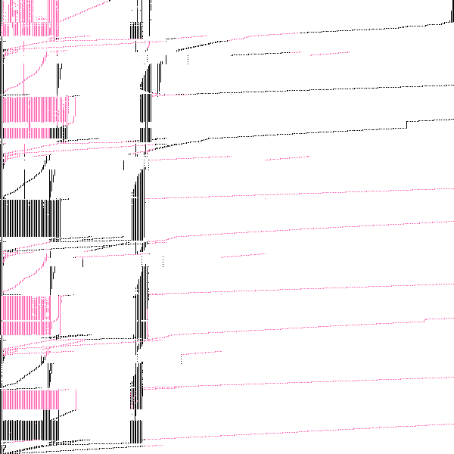
TLP Survey – 401.bzip2
13% Naïve Improvement
12% Improvement w/o DDG Interference

Slide 51
Coarse-Grained TLP and TLS
Best TLS performance for SPEC 2006 (Kejariwal PPOPP 2007)

Slide 52
Dynamic DDG Chopping
Dynamic Dependence Graph (DDG)
global integer A,B
1: string S = read(“myint.txt”)
2: integer C = integer(S)
3: A = someFunc()
4: B = A + C
4
2
3
1

Slide 53
Reverse Slicing
global integer A,B
Simulated Thread γ
1: string S = read(“myint.txt”)
2: integer C = integer(S)
4: B = A + C
Simulated Thread β
3: A = someFunc()

Slide 54
Dynamic DDG Chopping
global integer A,B
Region γ
1: string S = read(“myint.txt”)
2: integer C = integer(S)
4: B = A + C
Region β
3: A = someFunc()
Reverse Slice
Forward Slice

Slide 55
Performance Gain Conflicts
γ
β

Slide 56
Irrelevant Instruction Elimination
DINs
DINs
DINs
DINs
Output
Output
Output
Output
NULL
NULL
NULL
NULL

Slide 57
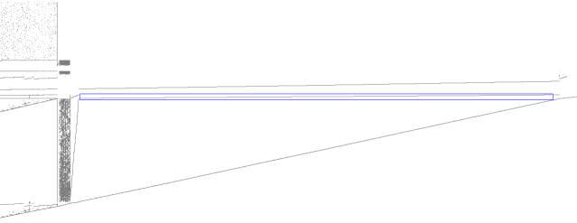
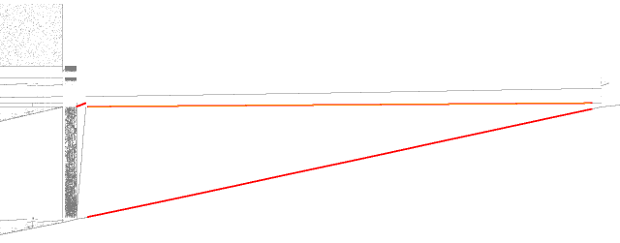
Case Study - Select and Slice β
γ
β
α
γ
β
α

Slide 58
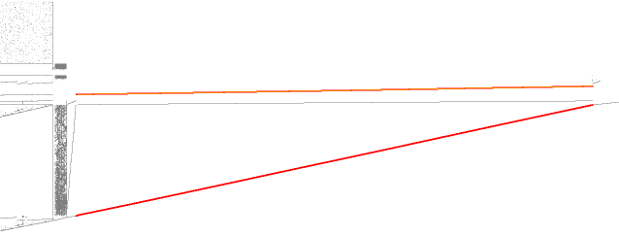
Case Study - Reverse Slice
Perform a single reverse data dependence slice on the selected region
γ
β
α

Slide 59
Binary Decision Diagram (BDD)
False Arc
Inverting
False Arc
True Arc
F(X,Y,Z,W) = X*Y*Z*W
X
Y
Y
W
W
W
W
Z
Z
Z
Z
Z
Z
Z
Z
0
0
0
0
0
0
0
0
0
0
0
0
0
0
0
1
0

Slide 60
The BDD Data Structure
False Arc
Inverting
False Arc
True Arc
F(X,Y,Z,W) = X*Y*Z*W
X
Y
Y
W
W
W
W
Z
Z
Z
Z
Z
Z
Z
Z
Z
0
1

Slide 61
The BDD Data Structure
False Arc
Inverting
False Arc
True Arc
F(X,Y,Z,W) = X*Y*Z*W
X
Y
Y
W
W
W
W
W
Z
Z
0
1

Slide 62
The BDD Data Structure
False Arc
Inverting
False Arc
True Arc
F(X,Y,Z,W) = X*Y*Z*W
X
Y
Y
W
W
Z
Z
0
0
1

Slide 63
The BDD Data Structure
False Arc
Inverting
False Arc
True Arc
F(X,Y,Z,W) = X*Y*Z*W
X
X
Y
W
Y
Z
W
Z
0
1
1

Slide 64

Trace BDD Construction Cont..
Unique Table
X
X
X
X
Compute Cache
Y
Y
Y
Y
W
W
W
1
=
1
+
Z
Z
Z
Z
Dead Nodes
I_{trace} = 0
1
1
1
1
f_{d1} = (X’ * Y’ * Z’ * W)
f_{trace} = (X’ * Y’ * Z’ * W’)
f_{d0} = (X’ * Y’ * Z’ * W’)
f_{trace} = (X’ * Y’ * Z’ * W’) + (X’ * Y’ * Z’ * W)

Slide 65
Trace BDD Construction Cont..
Unique Table
X
X
X
Compute Cache
Y
Y
Y
W
W
=
+
Z
Z
Z
Dead Nodes
1
1
1
f_{trace}
f_{d3} = (X’ * Y’ * Z * W’)

Slide 66
BDD Garbage Collection Time

Slide 67
ZDDs
BDDs
Remove isomorpic graphs
Skip and remove nodes whose pointers point to the same child
ZDDs
Remove isomorpic graphs
Remove nodes whose “then” arc points to the constant 0

Slide 68
Trace ZDD Construction
Unique Cache
f_{trace} = (X’ * Y’ * Z’ * W’) + (X’ * Y’ * Z’ * W)
Compute Cache
W
W
+
=
Dead Nodes
1
0
1
0
1
0
f_{d0} = (X’ * Y’ * Z’ * W’)
f_{d1} = (X’ * Y’ * Z’ * W)

Slide 69
Trace ZDD Construction
Unique Cache
Compute Cache
Z
W
Z
+
=
W
Dead Nodes
1
0
1
0
1
0
f_{trace}
f_{d3} = (X’ * Y’ * Z * W’)
f_{trace (new)}

Slide 70
Trace ZDD Gains
~ 20% Reduction

Slide 71
Trace ZDD Losses
3x Slower!

Slide 72
Trace ZDD Construction
Unique Cache
Compute Cache
Z
W
Z
+
=
W
Death Row
1
0
1
0
1
0
f_{trace}
f_{d3} = (X’ * Y’ * Z * W’)
f_{trace (new)}

Slide 73
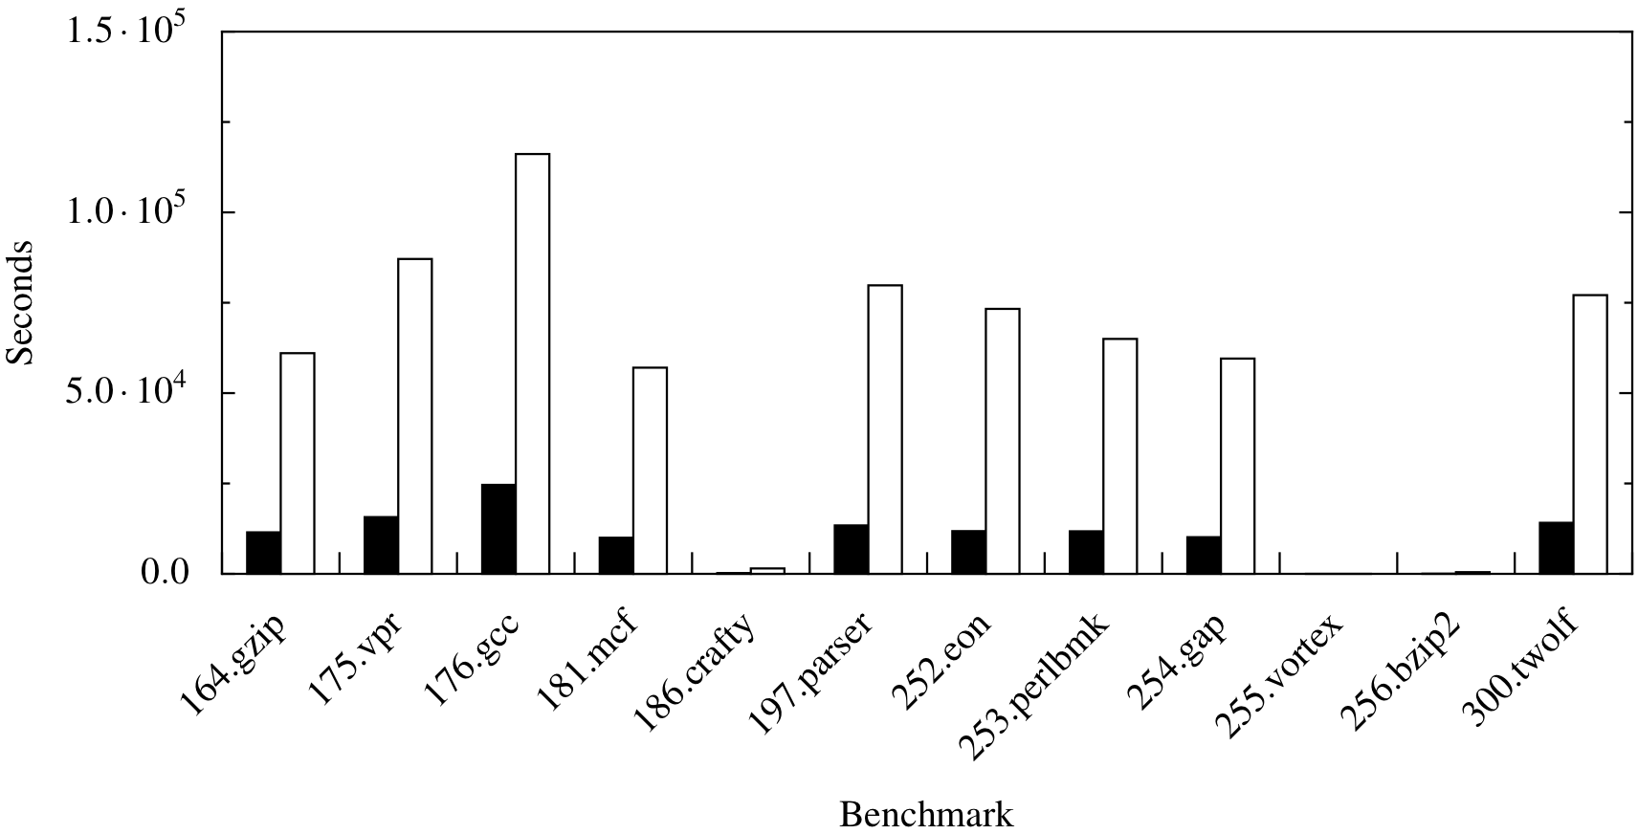
Trace ZDD Construction
DIN x RDY Tuples
Over 9 times faster!

